Slide 1
OP AMP
VISHAL BHARADWAJ
IITBBS0125-10403

Slide 2
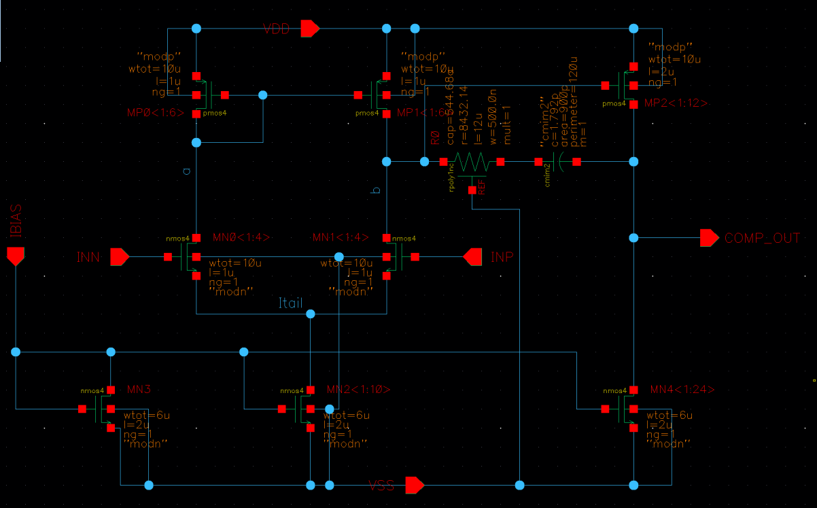
Schematic given

Slide 3
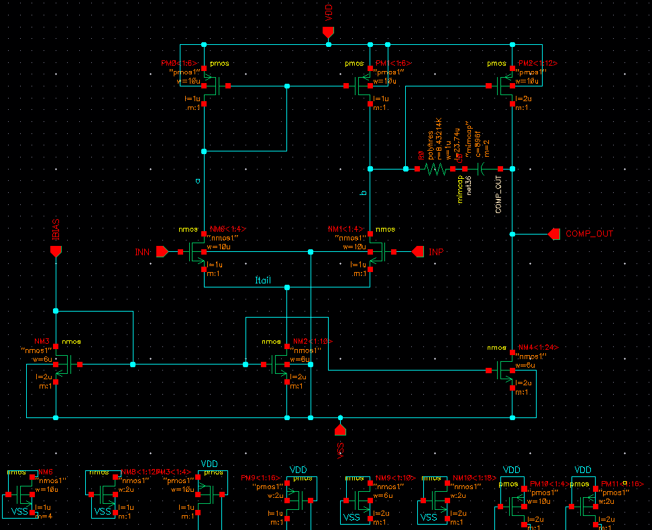
Schematic Snap shot

Slide 4
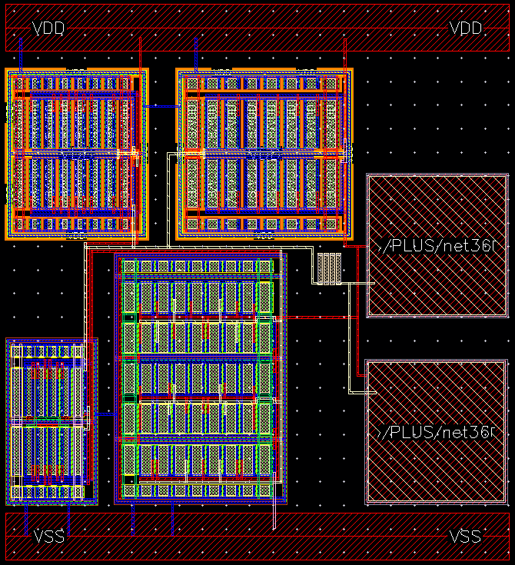
Layout Snap shot
X=107.02um
Y=118.01um

Slide 5
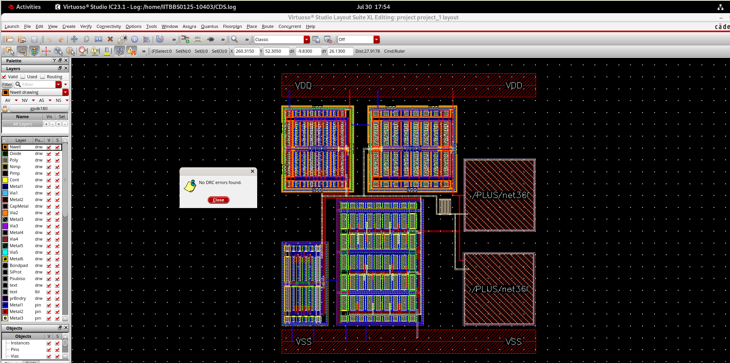
Layout Reports
→DRC report

Slide 6
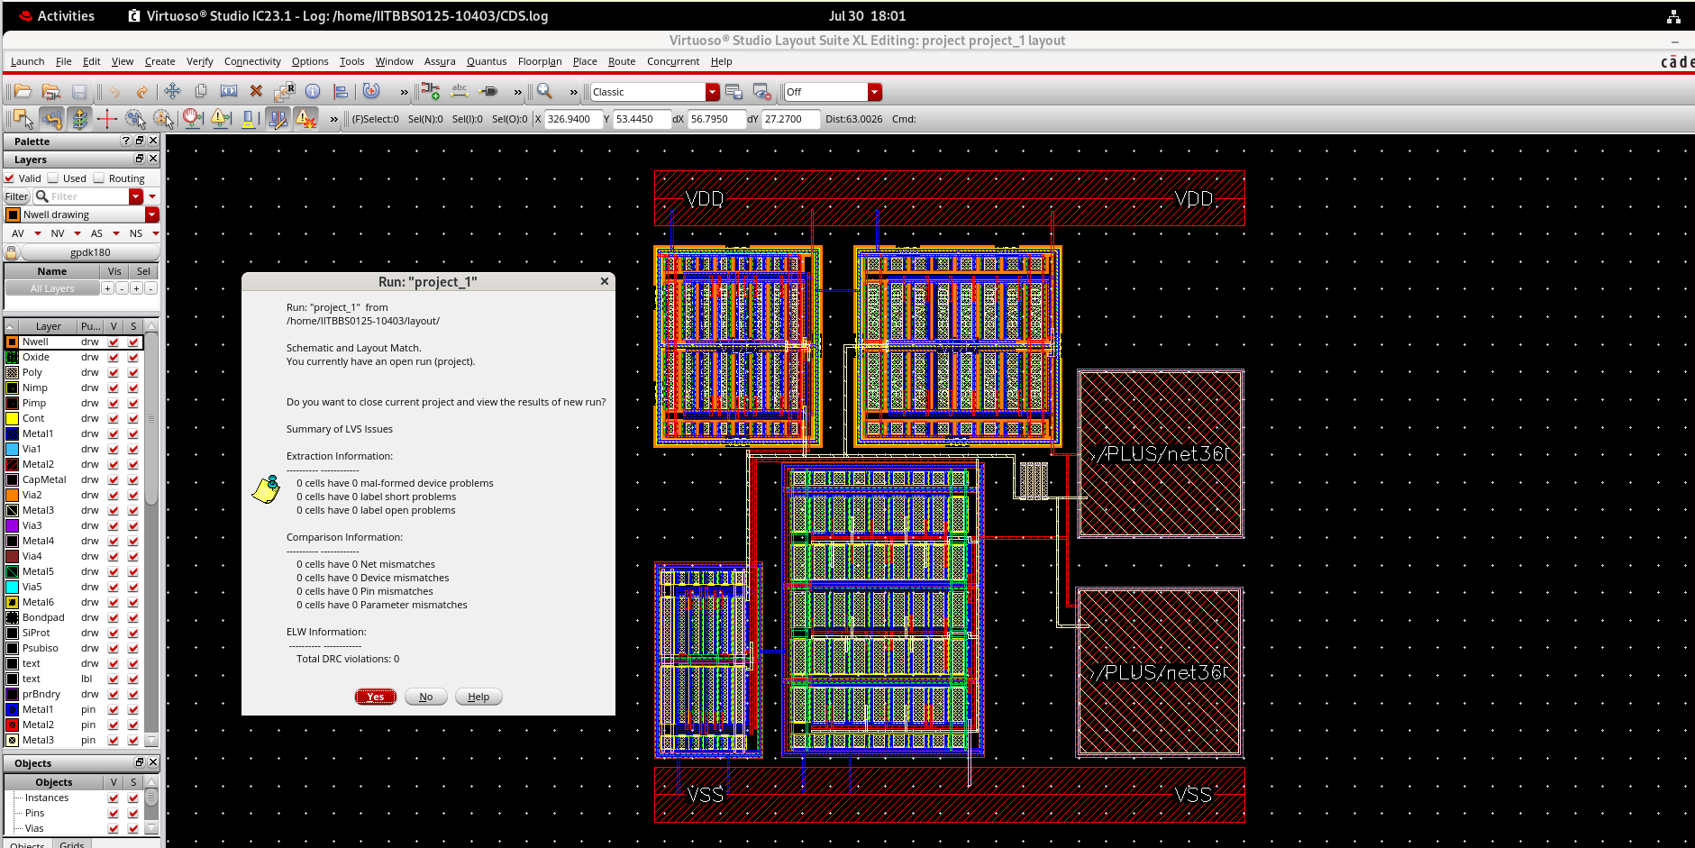
LVS Report

Slide 7
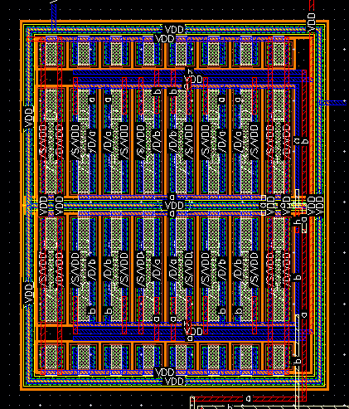
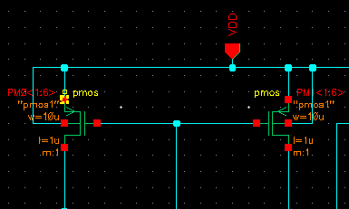
matching set 1
Pattern→ AABBAA
BBAABB

Slide 8
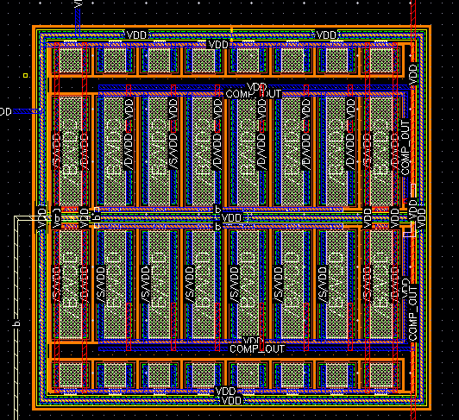
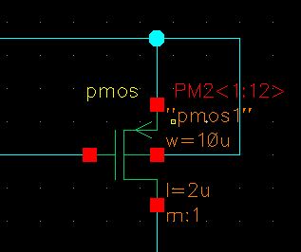
matching set 2

Slide 9
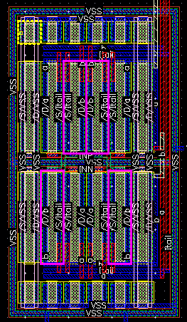
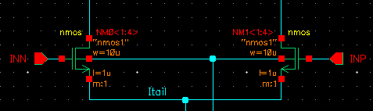
matching set 3
Pattern→ ABBA
BAAB

Slide 10
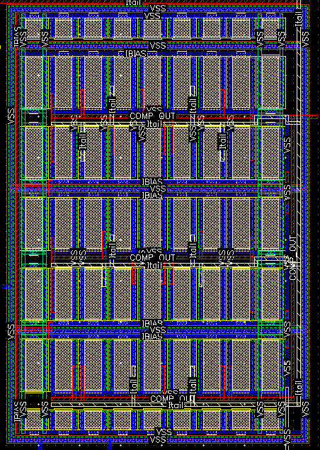
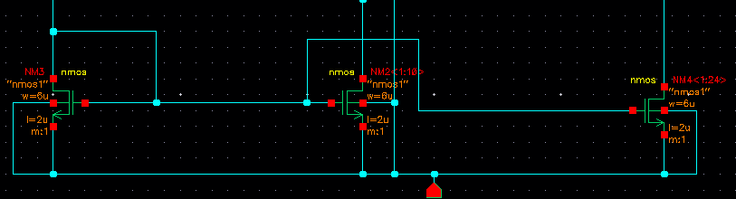
matching set 4
Pattern→ CCBCBCC
CBCCCBC
CCBABCC
CCBCBCC
CBCCCBC

